Slide 1

ORIENTATION
The AI Revolution
Starts Here
A beginner-friendly guide with real-world analogies.
No tech background needed — just curiosity.

Slide 2
What We'll Cover Today
01
What is AI, Really?
06
Your Personal AI Delegate
02
From 'Smart Tool' to 'Smart Worker'
07
Two Ways to Use AI
03
What is Agentic AI?
08
The 7 Golden Rules
04
The Agent Factory Idea
09
A Real Example: Ecomm Mart
05
The 10-80-10 Rhythm
10
Key Vocabulary & What's Next

Slide 3

PART 01
What is AI, Really?

Slide 4
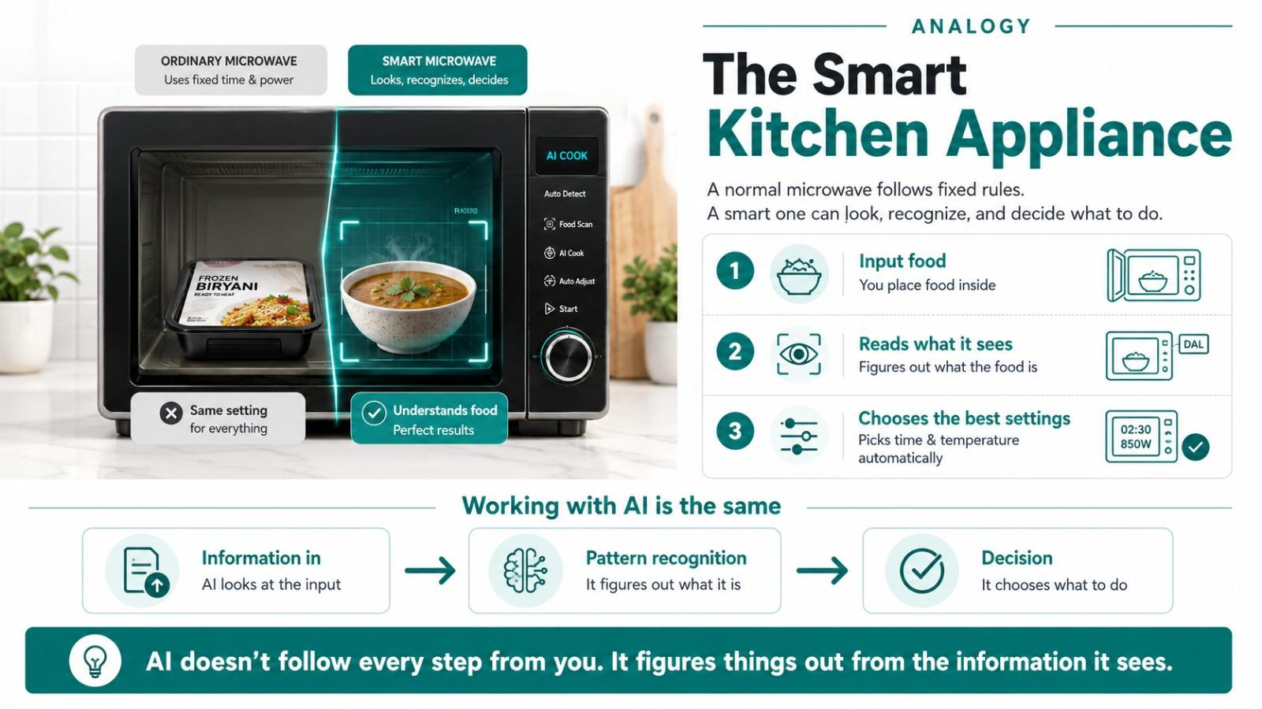
Notes:
Think about a microwave oven. You put food inside, press some buttons, and it heats the food. The microwave doesn't "understand" food — it just follows rules.
Now imagine a microwave that could LOOK at the food, figure out what it is (frozen biryani vs. leftover dal), and AUTOMATICALLY choose the right time and temperature.
That "figuring it out" part is what AI does. AI is software that can look at information, find patterns, and make decisions — without a human telling it every single step.

Slide 5
Breaking Down "Artificial Intelligence"
Artificial
Intelligence
Made by humans, not by nature.
A plastic flower is artificial.
AI is intelligence built from software.
The ability to learn, understand,
and make decisions.
Humans have natural intelligence.
AI has a version built from data.
Everyday Examples You Already Use
Google Translate
YouTube Recs
Auto-correct
ChatGPT / Claude
Reads Urdu, gives English
Spots patterns in what you like
Predicts the word you meant
Writes answers from questions

Slide 6

KEY TAKEAWAY
AI is software that can learn from data and make decisions on its own — without a human giving it step-by-step instructions every time.
It's not magic. It's math, data, and clever programming.
And it's already everywhere in your daily life.

Slide 7

PART 03
What is Agentic AI?

Slide 8
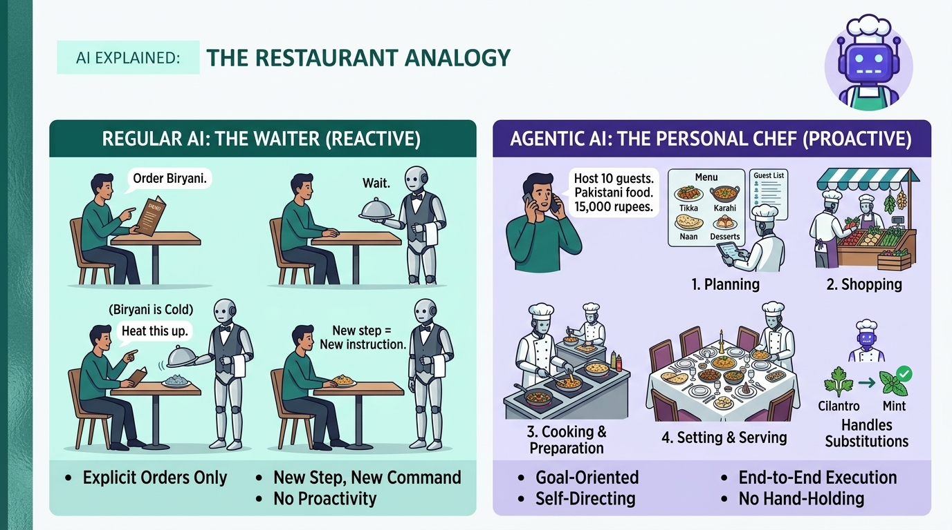
Notes:
REGULAR AI is like a waiter who only takes your order. You say "I want biryani." The waiter brings it. If the biryani is cold, the waiter just stands there. You have to say "heat this up." Every step needs a new instruction.
AGENTIC AI is like a personal chef. You say "I'm having 10 guests tonight. Pakistani food. Budget 15,000 rupees." The chef plans the menu, shops for ingredients, cooks everything, sets the table, and serves. If something runs out, the chef finds a substitute. No hand-holding needed.

Slide 9
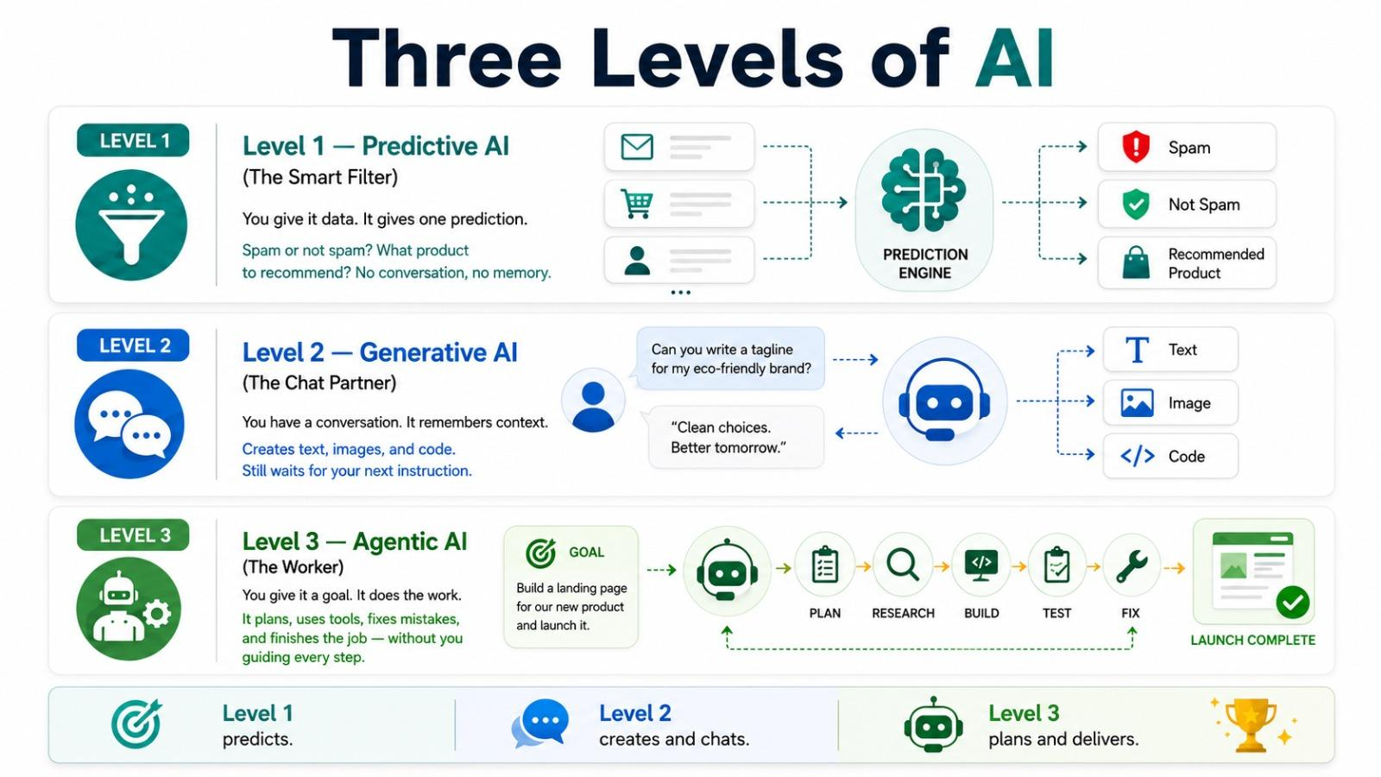

Slide 10




What Makes AI "Agentic"?
Four abilities that turn a chatbot into a worker:
Planning
Tool Use
Breaks a big goal into smaller steps and decides the order
Browses the web, writes code, reads files, sends messages
Self-Correction
Goal Completion
Notices mistakes and tries a different approach on its own
Works until the job is done, not just one answer

Slide 11
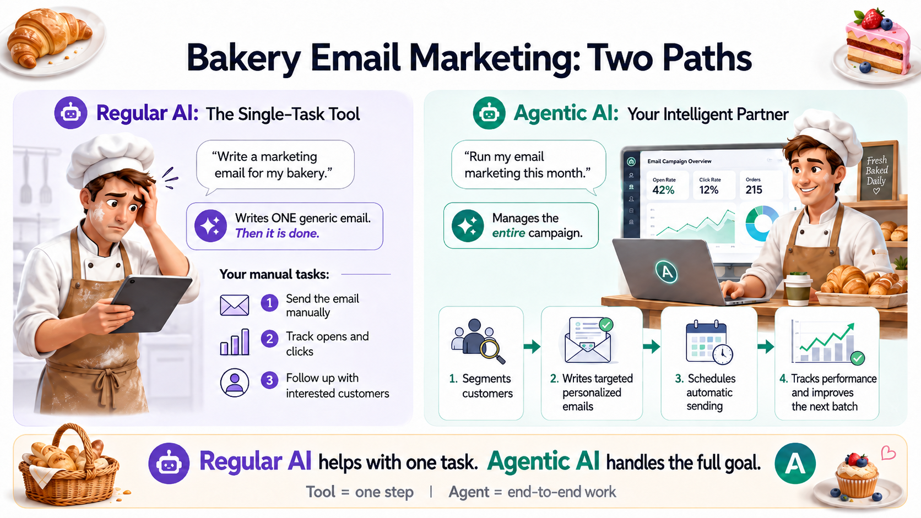

Slide 12

PART 02
From "Smart Tool"
to "Smart Worker"

Slide 13
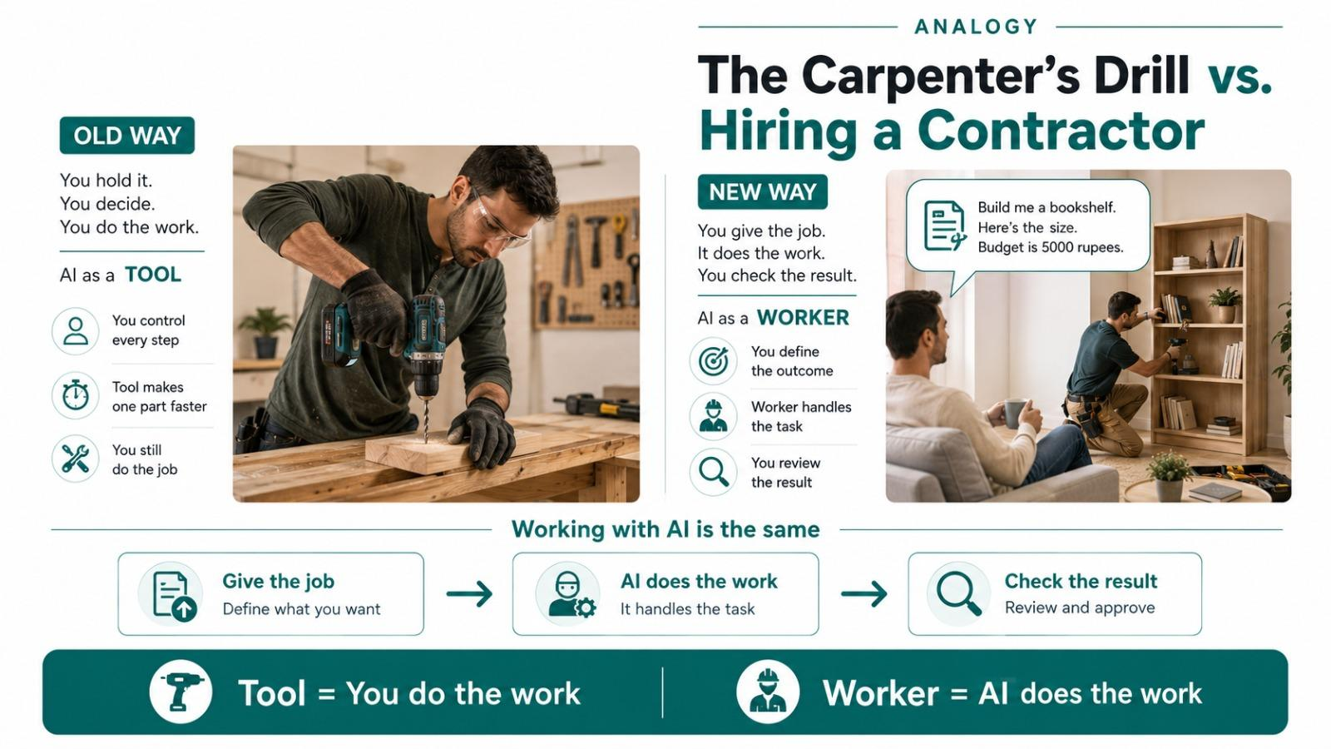
Notes:
OLD WAY — You buy an electric drill. It's powerful, but YOU still hold it. YOU decide where to drill. YOU do all the work. The drill just makes one part faster. That's AI as a TOOL.
NEW WAY — You hire a contractor. You say: "Build me a bookshelf. Here's the size. Budget is 5000 rupees." Then you go do something else. The contractor does the work. You come back and check.
That's AI as a WORKER. You give it the job. It does the work. You check the result.

Slide 14
KEY TAKEAWAY
The biggest shift in AI right now isn't about making smarter tools. It's about turning AI from a tool you use into a worker you hire.
You stop paying for access to software.
You start paying for finished results.

Slide 15

PART 04
The Agent Factory Idea

Slide 16
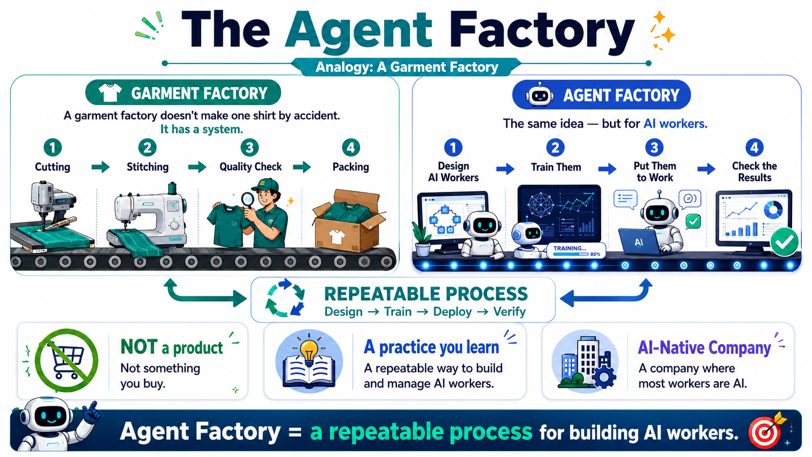
Notes:
A garment factory doesn't make one shirt by accident. It has a SYSTEM: cutting station, stitching station, quality check, packing.
The Agent Factory is the same idea — but for AI workers. It's a repeatable process to design AI workers, train them, put them to work, and make sure they do the job correctly.
The Agent Factory is NOT a product you buy.
It's a PRACTICE you learn.
And the company you build with it — where most workers are AI — is called an AI-Native Company.
A garment factory doesn't make one shirt by accident. It has a SYSTEM: cutting station, stitching station, quality check, packing.
The Agent Factory is the same idea — but for AI workers. It's a repeatable process to design AI workers, train them, put them to work, and make sure they do the job correctly.
The Agent Factory is NOT a product you buy.
It's a PRACTICE you learn.
And the company you build with it — where most workers are AI — is called an AI-Native Company.
A garment factory doesn't make one shirt by accident. It has a SYSTEM: cutting station, stitching station, quality check, packing.
The Agent Factory is the same idea — but for AI workers. It's a repeatable process to design AI workers, train them, put them to work, and make sure they do the job correctly.
The Agent Factory is NOT a product you buy.
It's a PRACTICE you learn.
And the company you build with it — where most workers are AI — is called an AI-Native Company.

Slide 17
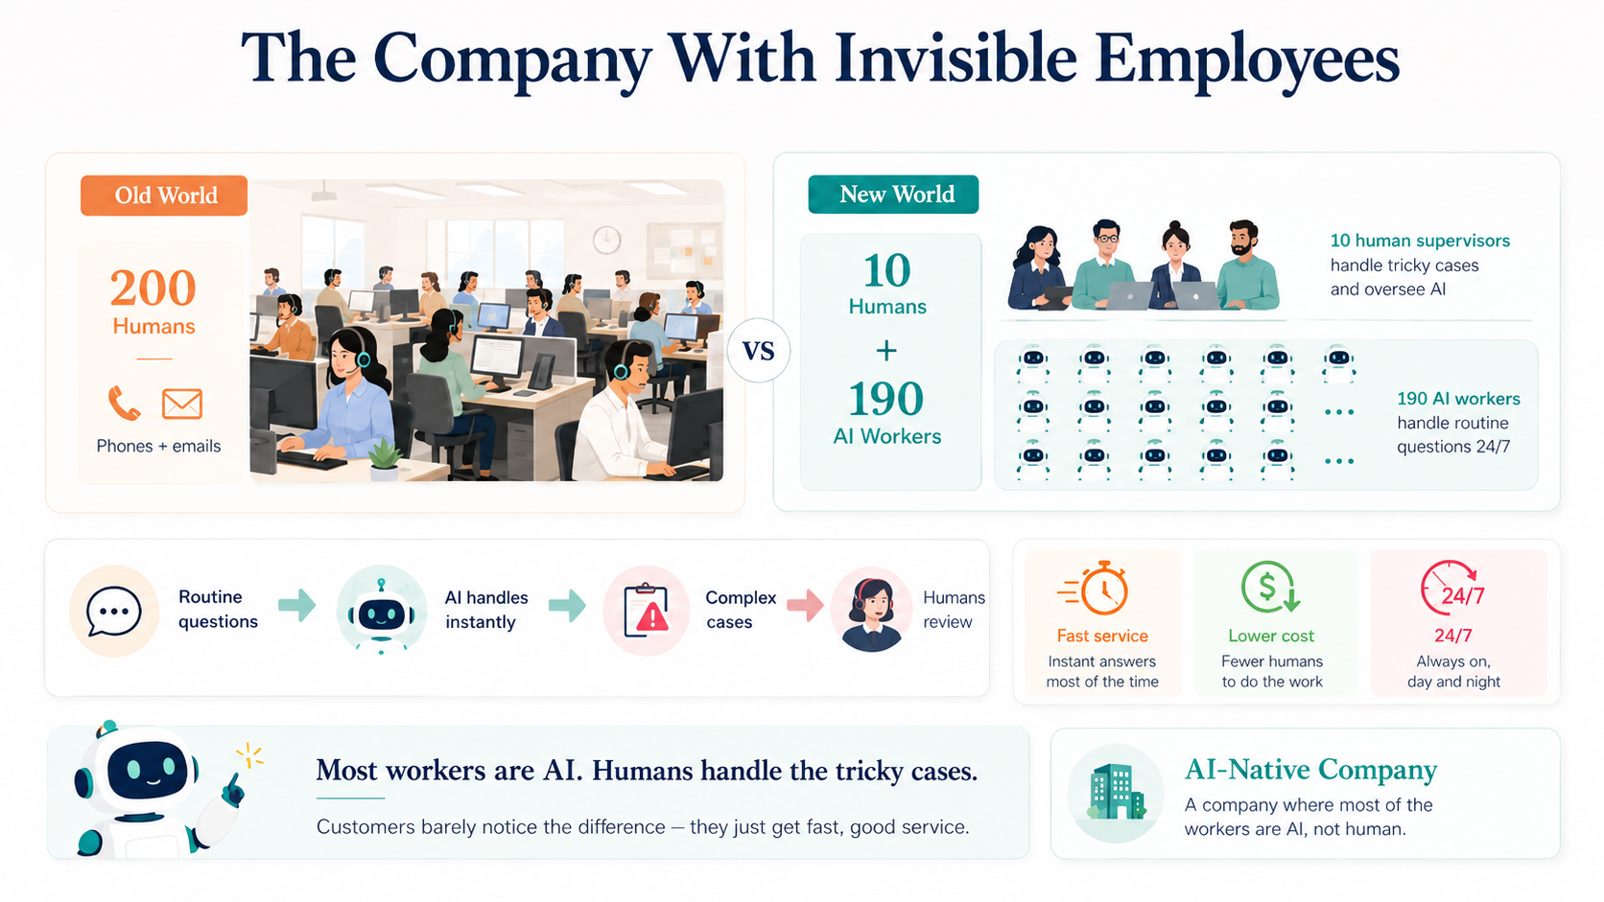
Notes:
Imagine a customer support company. In the old world, it has 200 human employees sitting in an office, answering phones and emails.
In the new world, the same company might have 10 humans and 190 AI workers. The AI workers handle the routine questions. The humans handle the tricky cases and make sure everything runs well.
The customers don't even notice the difference — they just get fast, good service. But the company's cost is much lower, and it works 24 hours a day.
This is an AI-Native Company — a company where most of the workers are AI, not human. And what it sells is whatever its AI workers produce.

Slide 18
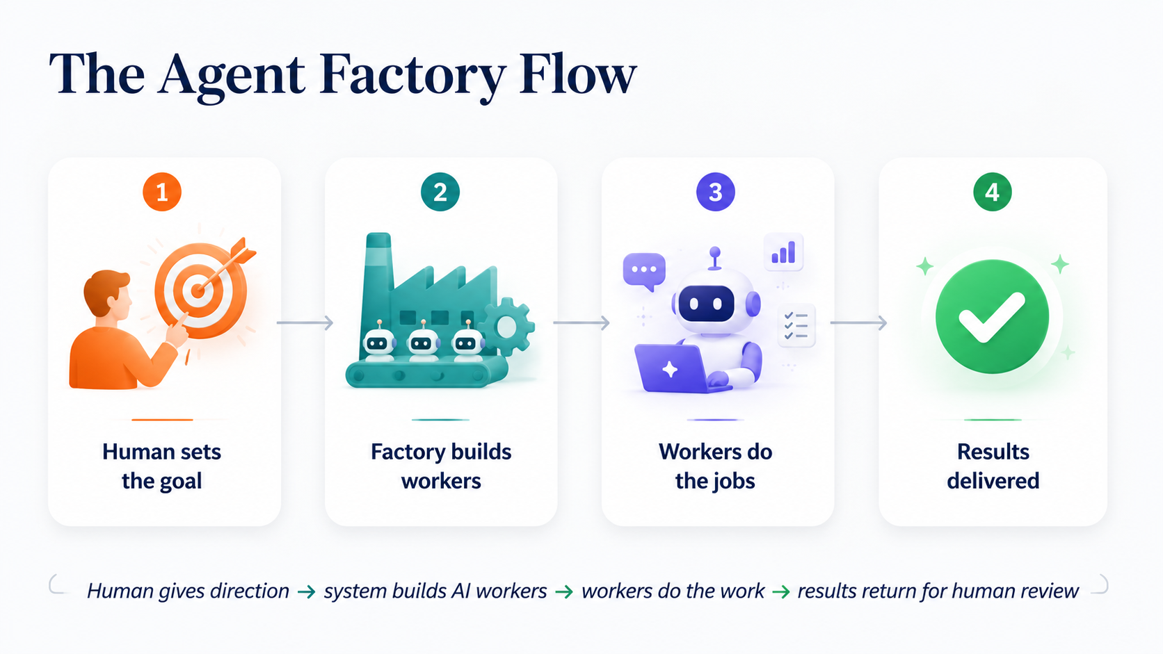

Slide 19

PART 05
The 10-80-10 Rhythm

Slide 20
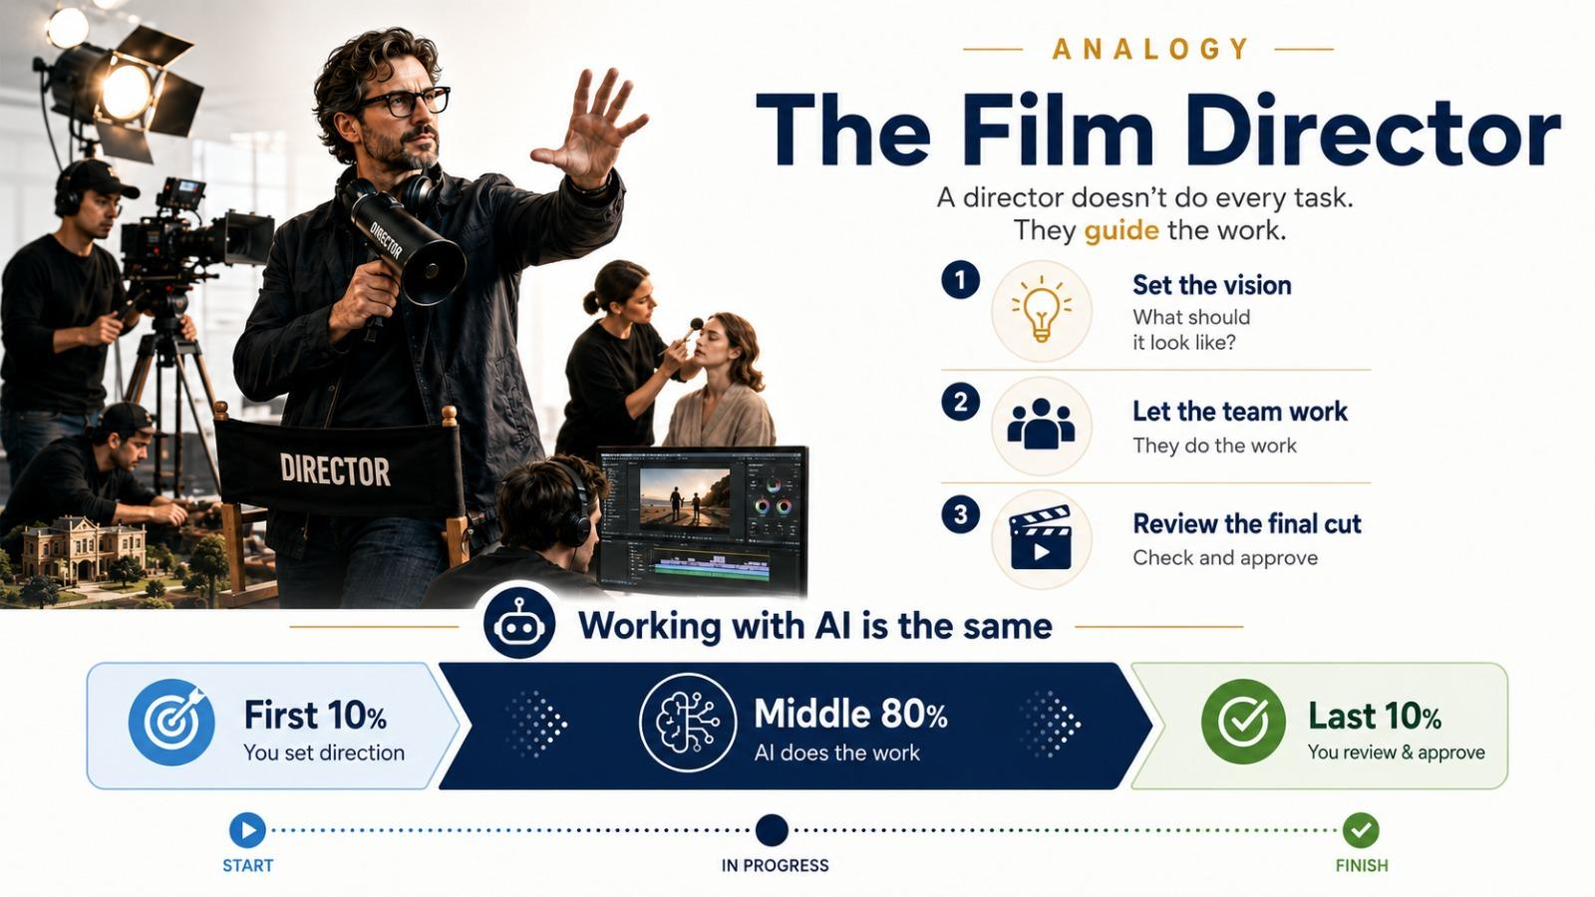
Notes:
A film director doesn't hold the camera, paint the sets, do the makeup, or edit the footage. The director does three things:
1. Tells everyone WHAT the film should look like (at the start)
2. Lets the team DO THE WORK (in the middle)
3. REVIEWS the final cut (at the end)
That's exactly how you'll work with AI.
First 10% = You set direction.
Middle 80% = AI does the work.
Last 10% = You check and approve.

Slide 21

The 10-80-10 Split
10%
80%
10%
Human sets
direction
AI does the work
Human checks
& approves
Three Things That Always Stay With Humans
Intent
Verification
Ownership
Knowing what you want
Checking if the work is good
Being responsible for the result

Slide 22

You're Promoted, Not Replaced
The Human Role
You are promoted, not replaced. From typist to editor. From coder to architect. From worker to director. AI takes over the middle 80%. You keep the parts that matter most — direction and judgment.
REAL EXAMPLE
Old Way
New Way
You spend 4 hours writing a business report yourself.
20 min writing clear instructions. AI writes the report in 5 min. 20 min reviewing and fixing. Same quality. One-tenth the time.

Slide 23

PART 06
Your Personal AI Delegate

Slide 24
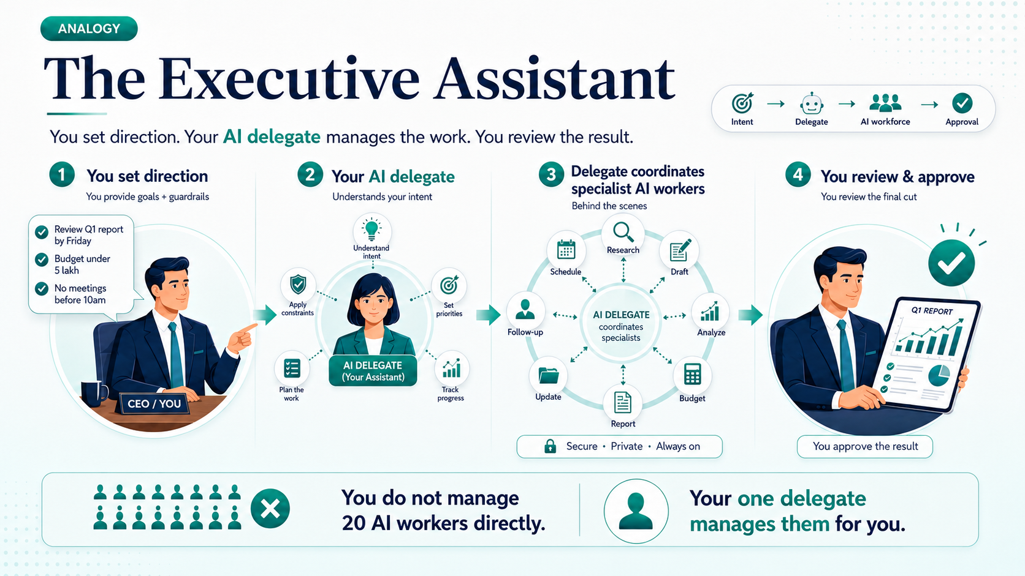
Notes:
Think of a busy CEO. The CEO doesn't personally answer every email, schedule every meeting, or follow up with every department. They have an executive assistant (EA) who knows how the CEO thinks.
The CEO says: "I want the quarterly report reviewed by Friday. Marketing budget under 5 lakh. No meetings before 10am."
The EA handles everything else — based on knowing the CEO's preferences.
Your AI delegate is your digital executive assistant. It knows your preferences, carries your authority, and manages the AI workforce on your behalf.
You don't talk to 20 AI workers. You talk to your ONE delegate.

Slide 25
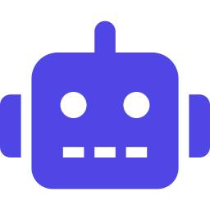
The Two-Layer Model
EDGE LAYER
→
Your personal AI that knows your preferences,
carries your authority, and manages workers.
You
Your Delegate
AI WORKFORCE LAYER
Support
Worker
Finance
Worker
Sales
Worker
Legal
Worker

Slide 26

PART 07
Two Ways to Use AI

Slide 27
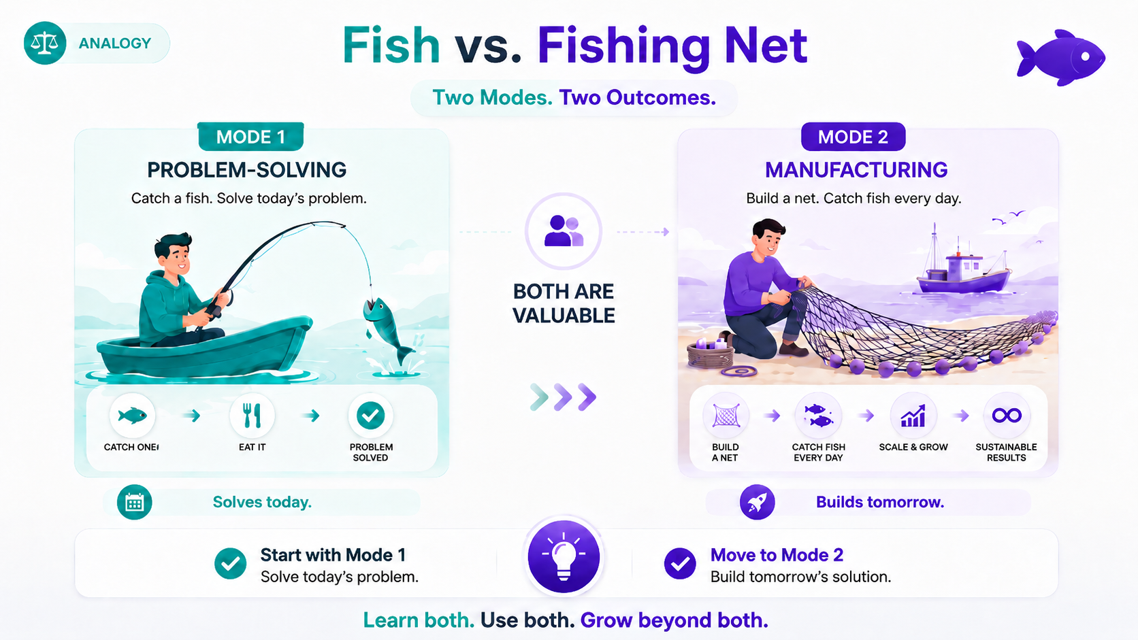
Notes:
MODE 1 — PROBLEM-SOLVING
Like catching a fish. You're hungry now, you catch one fish, you eat it. Problem solved. The session ends.
MODE 2 — MANUFACTURING
Like building a fishing net. You spend time building something that will catch fish for you every day — without you standing at the river.
Mode 1 solves today's problem.
Mode 2 builds tomorrow's solution.
Both are valuable. Most people start with Mode 1. The real power comes when you move to Mode 2. This program teaches you both.

Slide 28
Two Modes Side by Side
Mode 1 — Problem-Solving
Mode 2 — Manufacturing
"Help me do this thing right now."
"Help me build a worker that does this job forever."
You have a problem. You use AI to solve it. The session ends. Nothing permanent is built.
Example: "Help me analyze this spreadsheet" or "Write me an email to my client."
You use AI to build a new AI worker that will keep running long after you close your laptop.
Example: "Build me a customer support bot that runs 24/7 and answers common questions."

Slide 29

PART 08
The 7 Golden Rules of
an AI Company

Slide 30
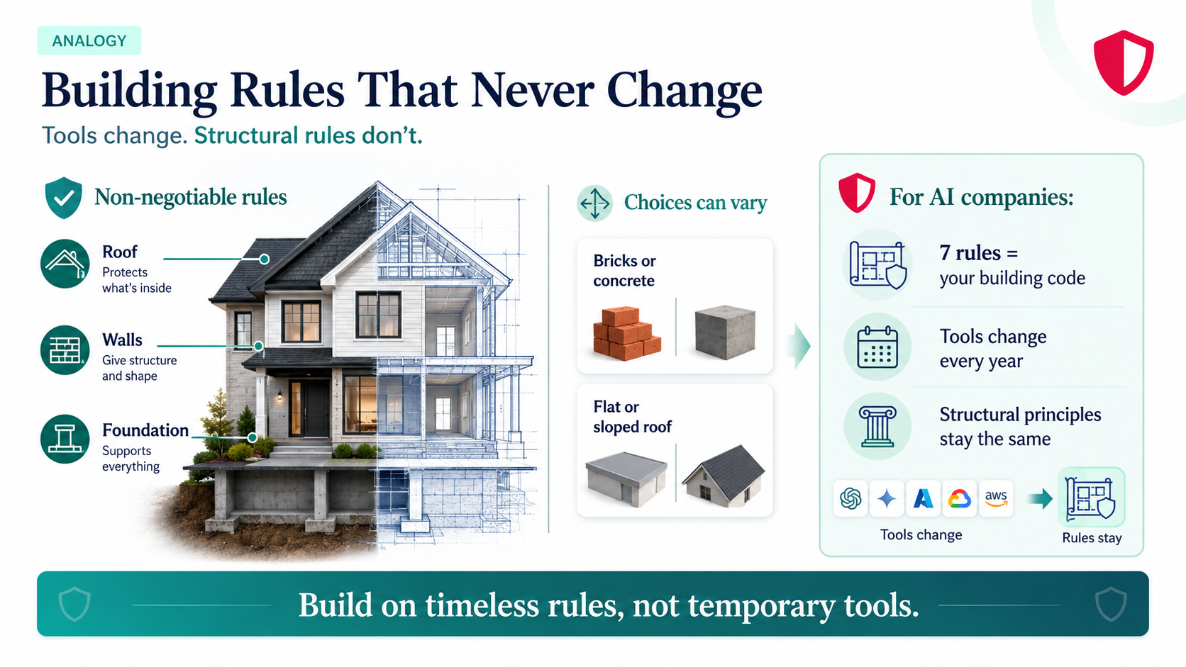
Notes:
When you build a house, some rules never change: it needs a strong foundation, it needs a roof, and it needs walls.
Whether you use bricks or concrete, whether the roof is flat or sloped — those are choices. But "the house must have a foundation" is a rule that never changes.
These 7 rules are the "building code" for AI companies. The specific tools and software will change every year. But these structural rules stay the same — just like the rules of good construction stay the same even when building materials change.

Slide 31
The 7 Golden Rules (1–4)
1
Human is always in charge
Every action traces back to a human. AI never sets its own goals.
2
Every human gets a delegate (identic AI)
You can't manage 20 workers by hand. Your delegate coordinates.
3
Workforce needs a management layer
Someone hires, assigns tasks, controls budgets, fires underperformers.
4
Each worker uses the right engine
Important work = reliable engine. Simple work = cheap engine.

Slide 32
The 7 Golden Rules (5–7)
5
Every worker uses a system of record
AI workers read/write the company's official memory. Without it, AI makes things up.
6
Workforce can grow under rules
When a gap appears, the system hires a new worker automatically — within human-set limits.
7
Company runs on a nervous system
Just like your body sends signals automatically,"hand touched something hot, pull back!" the AI company sends work between workers automatically. No human needed to pass tasks along. And if something breaks, the system recovers on its own.
Tools change. Rules stay.

Slide 33

PART 09
A Real Example:
Ecomm Mart

Slide 34
Building the Support Worker (Steps 1–3)
Step 1
Write Clear Instructions
Define the goal: read tickets, classify them, write replies, escalate hard cases. Set budget: $200/month max.
Step 2
Connect to Company Records
Link to Shopify orders, customer database, and ticket system so the AI can look up real data.
Step 3
Give It Skills
Teach it: how to write professional replies, how to classify tickets, when to escalate. Like a training manual.

Slide 35
Building the Support Worker (Steps 4–5)
Step 4
Set the Guardrails
Budget cap, approval for big refunds, audit trail of every action. The AI can never go outside these limits, all will be define in specs
Step 5
Test, Then Deploy
Run on 100 old tickets first. Check results. Fix problems. Only then let it handle real customers.
Result: You just built a Digital FTE — a Full-Time Employee made of software. It works 24/7, stays within rules, and handles 80% of support tickets automatically.

Slide 36

PART 10
Key Vocabulary &
What's Next

Slide 37
Essential Vocabulary (1/2)
AI
Software that learns from data and makes decisions
Agentic AI
AI that plans, uses tools, fixes mistakes, completes jobs
AI Worker / Digital FTE
AI built to do one specific job, like a human employee
Agent Factory
The method for building AI workers (a practice, not a product)
AI-Native Company
Company where most workers are AI, selling results not tools

Slide 38
Essential Vocabulary (2/2)
Delegate
Your personal AI that manages the workforce for you
System of Record
Company's official memory — the single source of truth
Spec
Clear written instruction: goal, limits, budget, success criteria
10-80-10 Rule
Human direction (10%) + AI work (80%) + Human check (10%)

Slide 39
TODAY'S BIG IDEAS — IN ONE BREATH
AI is software that learns and makes decisions. Agentic AI takes this further — it plans, uses tools, and completes entire jobs.
The Agent Factory is the method for building AI workers and organizing them into AI-Native Companies where AI does the work and humans set direction and check quality.
You're not being replaced — you're being promoted from worker to director.
The future belongs to people who can clearly tell AI what to do, connect it to real data, and verify the results are correct.
That's what this program will teach you. Welcome aboard.

Slide 40
Thank You
Your journey into Agentic AI starts now.
Based on the Agent Factory Thesis
agentfactory.panaversity.org

